Slide 1
AUM2022
Title Subtitle
Author(s)
(Affiliations)
Area for images of people/lively scenes for non experts
Texts (max 350 words; ideally 150-250; can include small illustrations)
Area for technical images – ideally one big one only, but can include some small ones at the bottom – design for good composition
Email: (and other contact details where needed) ; you can include a QR code for easy transfer of contact details, etc

Slide 2
The following is an example from AUM2018

Slide 3
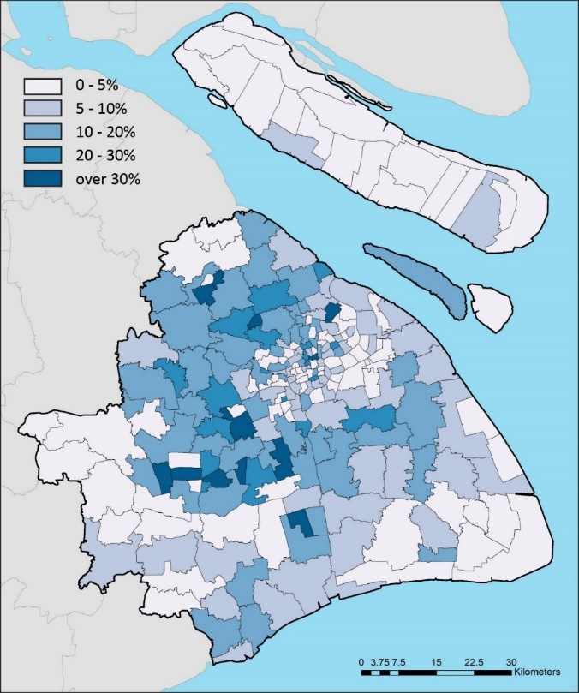
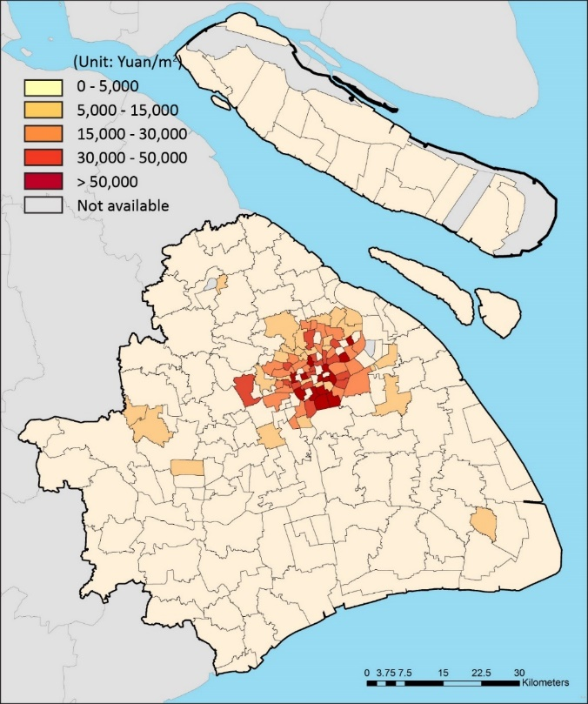
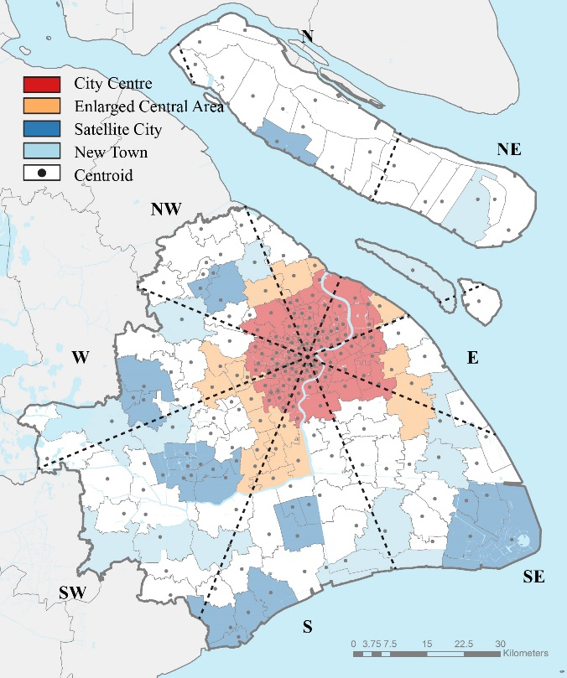
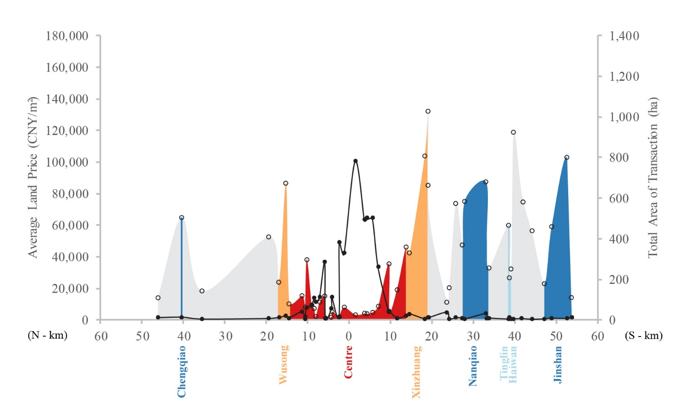
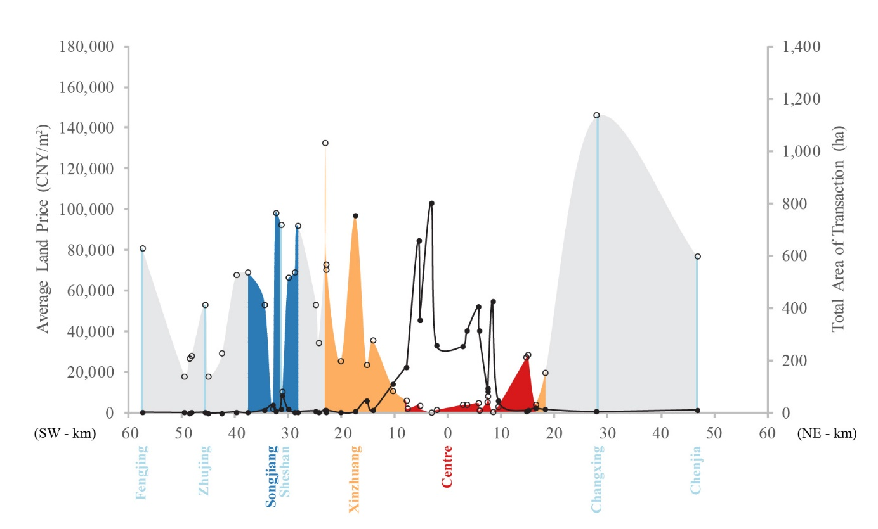
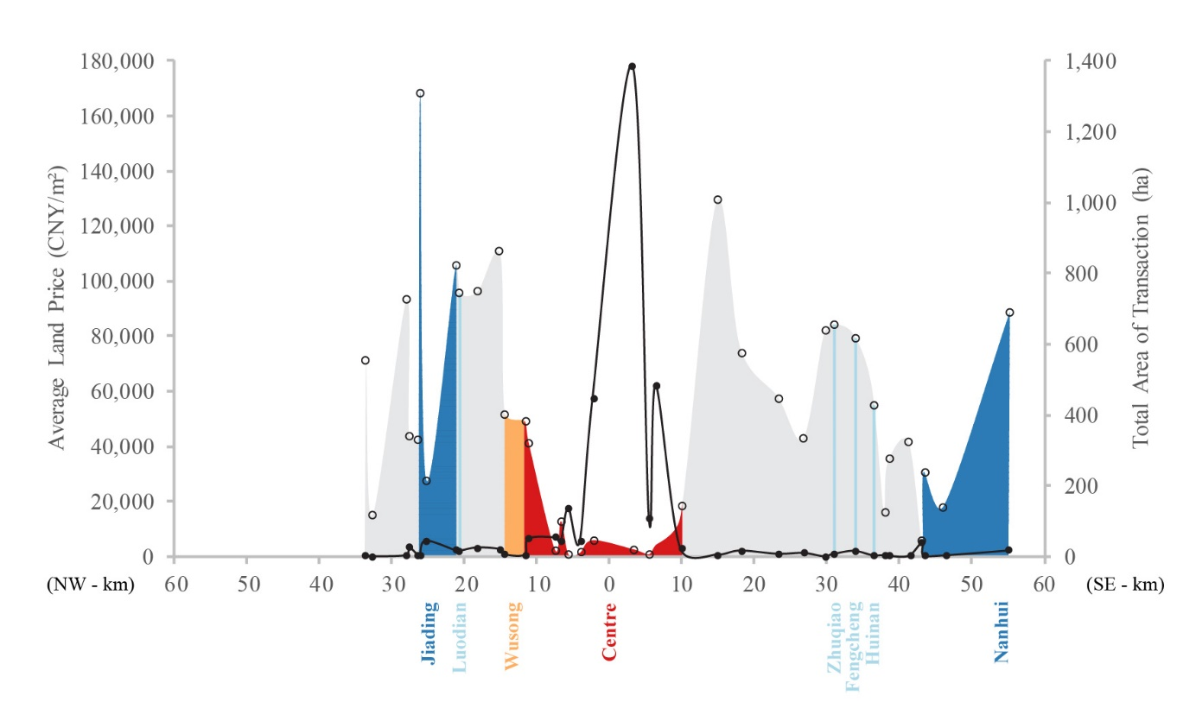
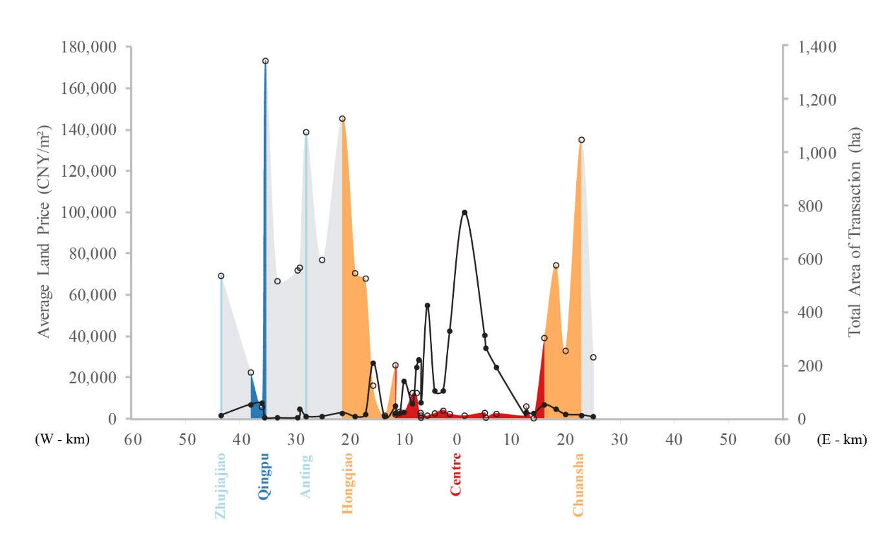
AUM2018
To What Extent is Shanghai a Polycentric City? Insights from Online Land Transaction Data 2001-2015
Tianren Yang & Ying Jin
(Department of Architecture, University of Cambridge)
Recent online publication of urban land transactions has opened a new window into the geographical patterns of urban growth since the early 2000s. The new data, which is made available at the site (or land parcel) level, consists of land area, land use type, financial? guarantees, date of sale, location, price and leasing period [others?]. Having checked and validated this data using existing sources, we investigate the extent that Shanghai is poly-centric. Whilst the transaction volumes show the distinct patterns for residential, commercial and industrial development (below), the land prices suggest that Shanghai is far from a polycentric structure (right). However, the data suggests that there are promising signs in six satellite cities and one new town which are worth watching. The data thus provides a new way to pinpoint locations for further empirical studies to learn what has worked and what has not in Shanghai’s quest for poly-centricity.
1980
1990
2000
2010
Spread of built-up areas in Shanghai (Source: …)
Limitations of existing data sources
Annual official statistics on land transactions take at last a year to appear and are not available at the site level
Satellite images require high levels of skill and local knowledge to process, and it is difficult to classify the purposes of use
Aerial photos, land use maps and land use databases are classified official data and not scrutinised in academic research
The new source we have used for this paper is China Land Market, an online platform of the Ministry of Land and Resources [check their current name]. The data includes
Land transactions, applicable to for-profit trades (35% of total sites???) such as residential, commercial and industrial
Land allocations, applicable to non-profit uses (65% of the sites) such as institutional and infrastructure uses
In this paper we use the land transactions data only
Online, instantaneous publication of site-level transactions and allocations now a legal requirement in China
This means that continuous and timely monitoring of land development data by academic researchers is now feasible
Rise in land transaction volume and price: opposing patterns
Land development sites
Fringe areas to historic core: rapid development and redevelopment here are shaping an expanded centre for Shanghai.
Far suburbs: new development stimulated by financial and fiscal incentives of the the municipal masterplan, which aims to develop a polycentric city.
Land prices
Peaks rise rapidly and remain in historic core;
Places worth watching:
6 of the 7 satellite cities
1 of the 13 new towns (i.e. Fengcheng)
Site areas and prices 2001-2015
Mark out the fringe area and the far suburbs
Mark out the satellite cities and new towns
Change title to ‘Axial analysis’ and mark the four axels clearly
There is space to put this map in
the middle of the four graphs
below
Transaction volume
Land price
Circular Sections
N-S
SW-NE
Pls change the legends to ‘residential sites’, ‘commercial sites’, ‘industrial sites’, ‘residential price’ etc
Residential sites: Rapid expansion of land areas in Satellite Cities vs fast rise in land prices in the Centre
NW-SE
W-E
Email: ty290@cam.ac.uk
Commercial sites: Continued expansion in all areas vs polarisation of land values
Change ‘enlarged central area’ to ‘Fringe of the Centre’
Conclusions
Industrial sites: From Expansion to Intensification beyond the Outer Ring
(1) This new online land transaction data has significant and untapped potential for identifying patterns of urban land development and changes in the property markets
Providing much greater spatial granularity (i.e., at the development site level) in a timely way; a critical supplement to existing sources on land use and land prices
(2) The land prices show that Shanghai is, strictly speaking, a one-centre metropolis
This singular centre has inched outwards into a fringe area; expansion into the far suburbs has not engendered new centres
(3) However, some planned sub-centres are worth watching
This includes 6 out of 7 satellite cities and one out of 13 new towns
Satellite cities have a higher political and administrative status.
(4) Continuous monitoring of this data helps to inform planning and investment strategies that support Shanghai’s quest for poly-centricity.

